Slide 1
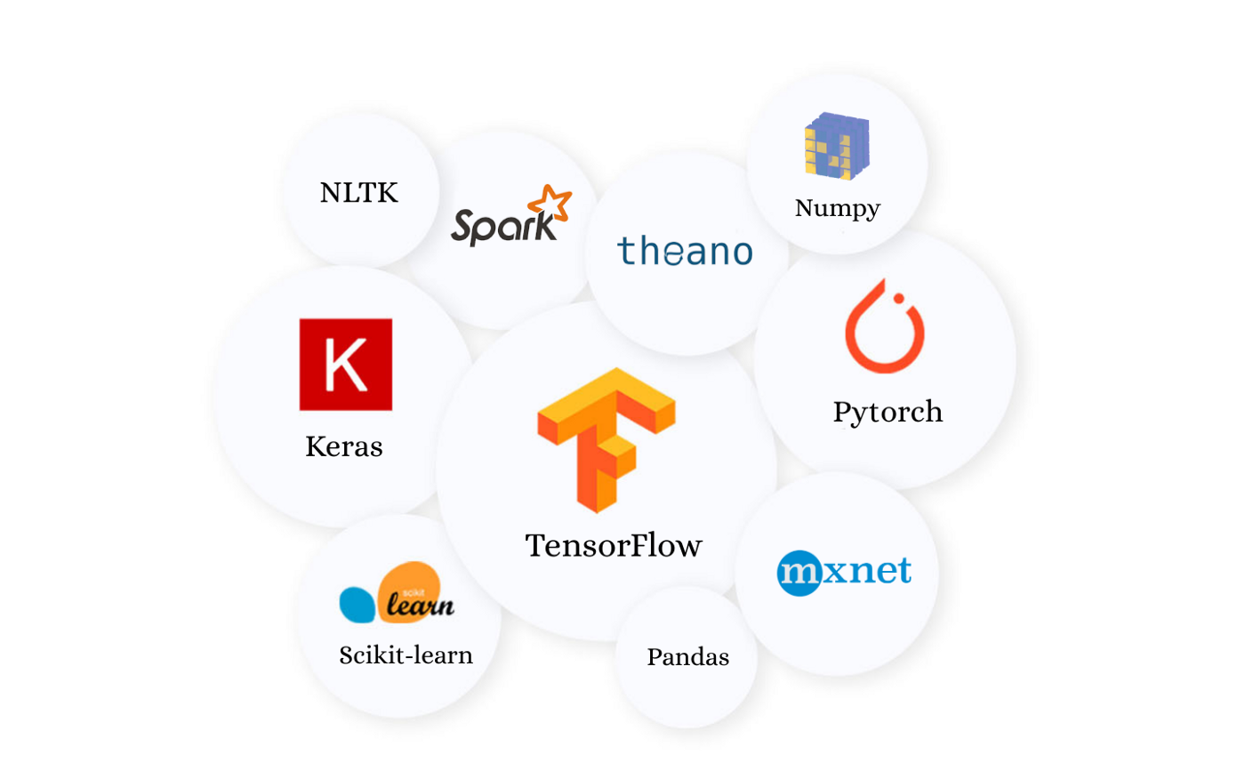
Python Data Processing and Machine Learning CFG Tutorial
Fraser King – December 2022
University of Waterloo

Slide 2
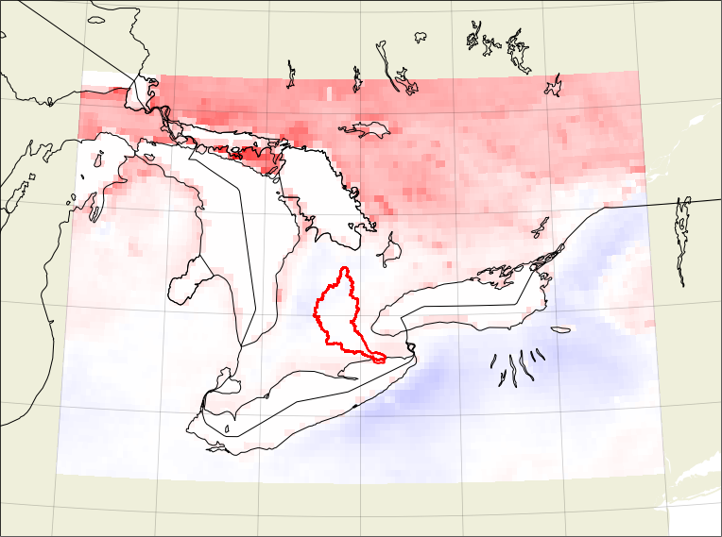
Overview
Project Links
Packages
Example Problem
Data
Live Demo

Slide 3
Project Links
Github:
https://github.com/frasertheking/RandomForestGeosciences
Google Colab:
http://bit.ly/3FpZBAE
TowardsDataScience:
https://bit.ly/3KGqm6g

Slide 4

Packages
We will examine a variety of Python packages for downloading data, unpackaging and processing data, geospatial plotting, masking and, of course, machine learning
All packages will be provided in the Google Colab notebook with links to relevant documentation
Using Python version 3.8.16
gdown
pandas
xarray
cartopy
regionmask
rioxarray
matplotlib
scikit-learn
scipy

Slide 5
Example Problem
How accurately can we predict monthly snowmelt data from other climate variable covariates in Ontario at 9km resolution?
Is this a classification or regression problem? A supervised or unsupervised problem? Linear or nonlinear?
Let’s download some climate data from ECMWF and perform tests using different models to see what levels of accuracy we can get using different predictor combinations

Slide 6
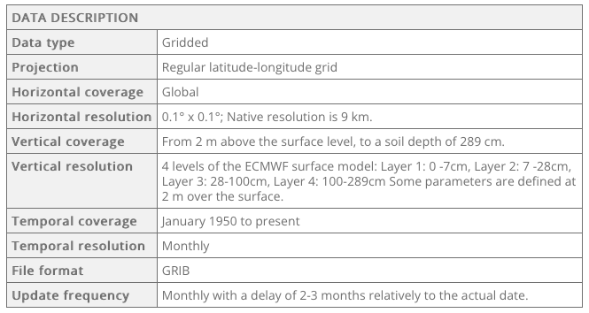
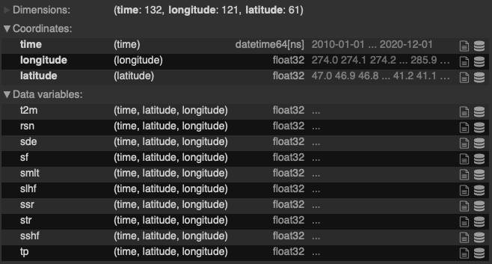
ERA5-Land monthly averaged data
We download 10 years of monthly data (2010 – 2020) from ERA5-Land (https://cds.climate.copernicus.eu/cdsapp#!/dataset/reanalysis-era5-land-monthly-means?tab=overview) and load it into Google Colab

Slide 7
ERA5-L Variable Reference Sheet
Short Name | Long Name | Units | Variable Type
smlt | Snowmelt | (m of water equivalent) | Response
t2m | 2 meter temperature | (K) | Predictor
tp | Total precipitation | (m) | Predictor
rsn | Snow density | (kg m**-3) | Predictor
sde | Snow depth | (m) | Predictor
sf | Snowfall | (m of water equivalent) | Predictor
slhf | Surface latent heat flux | (J m**-2) | Predictor
ssr | Surface net solar radiation | (J m**-2) | Predictor
str | Surface net thermal radiation | (J m**-2) | Predictor
sshf | Surface sensible heat flux | (J m**-2) | Predictor

Slide 8


Live Demo
Fraser
Google Colab:
http://bit.ly/3FpZBAE

